Slide 1
Department of CSE
COURSE NAME: Data science
COURSE CODE: 24AD3107
Topic:
Exploratory data analysis & Data visualization
Session - 1

Slide 2
AIM OF THE SESSION
To familiarize students with the basic concept of Exploratory data analysis and data visualization
INSTRUCTIONAL OBJECTIVES
This Session is designed to: Introduction to Exploratory data analysis and data visualization
LEARNING OUTCOMES
At the end of this session, you should be able to: basic knowledge of EDA & DV

Slide 3
Key Concepts
SESSION INTRODUCTION
Introduction to EDA
Types of EDA
Introduction to Data Visualization

Slide 4
Introduction to data visualization
Data visualization is an important component of Exploratory Data Analysis (EDA) because it allows a data analyst to “look at” their data and get to know the variables and relationships between them. In order to choose and design a data visualization,
It is important to consider two things:
The question you want to answer (and how many variables that question involves).
The data that is available. (is it quantitative or categorical?)
Exploratory Data Analysis (EDA) is an important step in data analysis where we explore, summarize, and visualize data to understand its structure, detect patterns, identify anomalies, test assumptions, and check relationships between variables before applying any machine learning or statistical models.
5

Slide 5
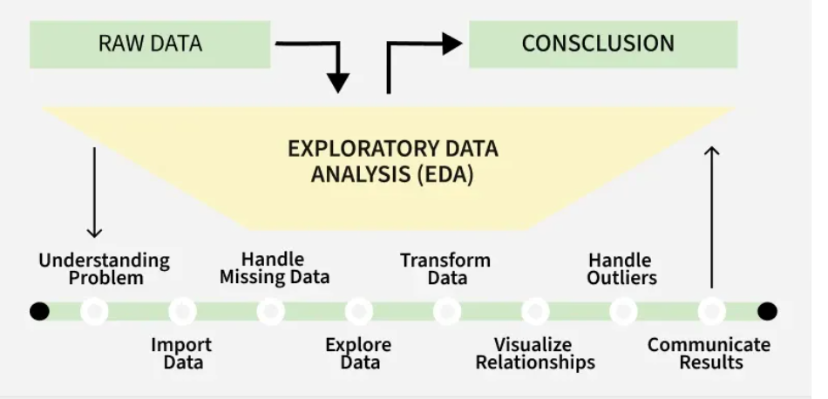
Importance
Provides a clear understanding of the dataset, including the number of features, data types and data distribution.
Reveals patterns and relationships between different variables in the data.
Identifies errors and outliers that may affect analysis.
Highlights the most important features useful for building models.
Supports selecting suitable modelling techniques for better results.

Slide 6
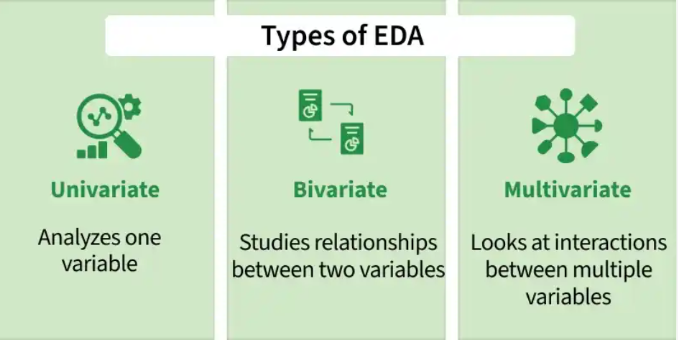
WHAT IS IMPORTANT?
We’ll use data visualization to explore a dataset, which contains information about housing
rentals in New York City. The first few rows of the dataset are printed below

Slide 7
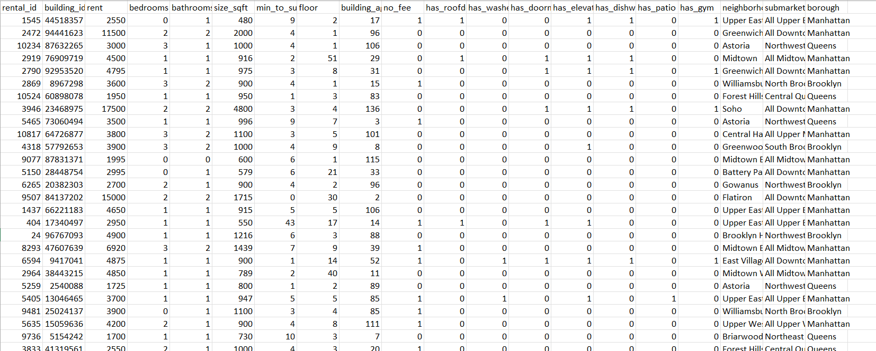

Slide 8
What is univariate analysis?
Univariate analysis focuses on a single variable at a time. Univariate data visualizations can help us answer questions like:
What is the typical price of a rental in New York City?
What proportion of NYC rentals have a gym?
Depending on the type of variable (quantitative or categorical) we want to visualize, we need to use slightly different visualizations.
Histograms: Show how data values are distributed.
Box plots : Help detect outliers and show data spread.
Bar charts : Used for categorical variables.
How to visualize quantitative variables?
Box plots (or violin plots) and histograms are common choices for visually summarizing a quantitative variable. These plots are useful because they simultaneously communicate information about minimum and maximum values, central location, and spread. Histograms can additionally illuminate patterns that can impact an analysis (eg., skew or multimodality).
For example, suppose we are interested in learning more about the price of apartments in NYC. A good starting place is to plot a box plot of the rent variable.

Slide 9
Bivariate Analysis
Bivariate analysis examines the relationship between two variables to understand how they interact or influence each other. Common techniques include:
Scatter plots: Show the relationship between two numerical variables.
Correlation coefficient: Measures the strength of the relationship between variables .
Cross-tabulation: Displays the relationship between two categorical variables.
Line graphs: Compare two variables over time to identify trends.
Covariance: Shows how two variables change together.

Slide 10
Multivariate Analysis
Multivariate analysis studies three or more variables together to understand complex relationships within the dataset. Common techniques include:
Pair plots: Show relationships between multiple variables at once.
Principal Component Analysis (PCA): Reduces dimensionality while preserving important information.
Spatial analysis: Analyzes geographical patterns using maps and location-based data.

Slide 11
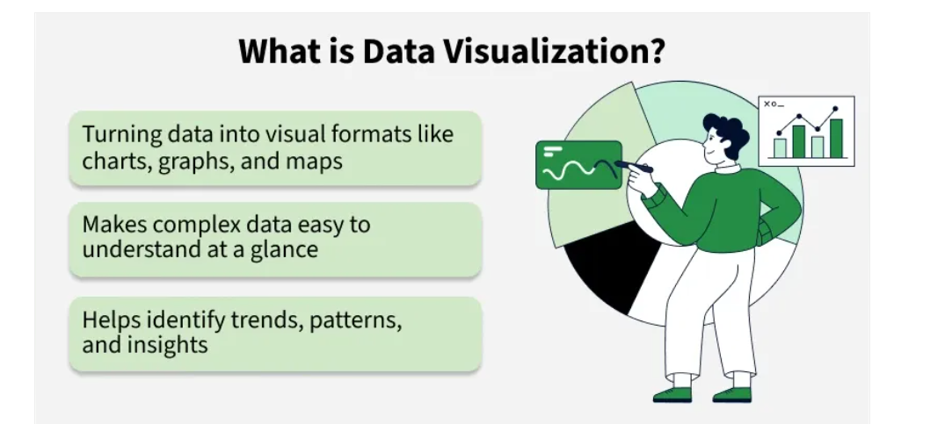
Introduction to Data Visualization
Data visualization uses charts, graphs and maps to present information clearly and simply. It turns complex data into visuals that are easy to understand. With large amounts of data in every industry, visualization helps spot patterns and trends quickly, leading to faster and smarter decisions.

Slide 12
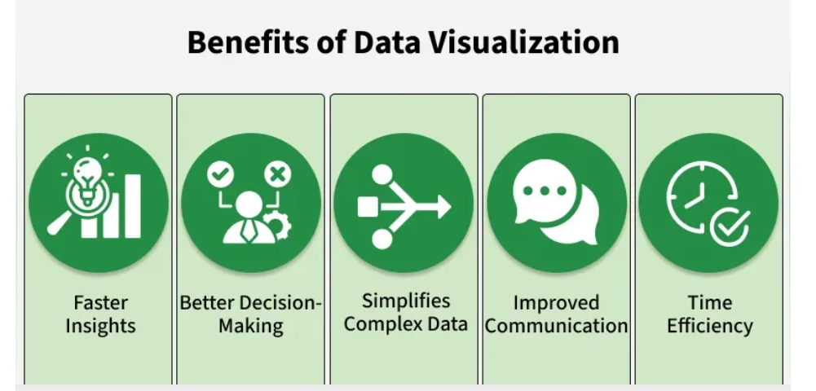
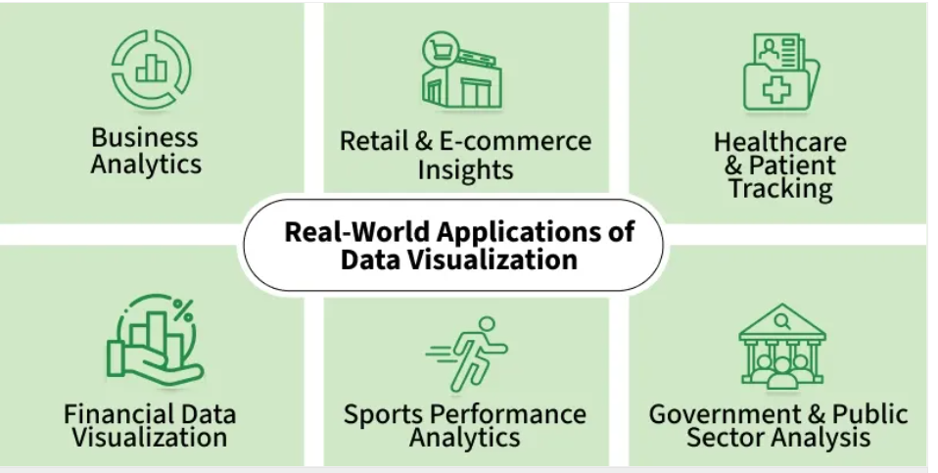

Slide 13
Common Types of Data Visualization
Charts and Graphs: They are used to visualize data, with charts comparing data points across categories or showing trends over time and graphs analyzing relationships between variables to identify correlations, trends and outliers. Examples: Bar Charts, Line Charts, Pie Charts, Scatter Plots, Histograms, Box Plots.
Maps: They are used to display geographical data which provides spatial context to trends and patterns. Examples: Geographic Maps, Heat Maps
Dashboards: They combine multiple visualizations into a single interface which provides real-time insights and interactive features for users to explore data.

Slide 14
Importance of Data Visualization
Data visualization is essential for understanding and communicating information effectively. Here are some key reasons why it's important:
Simplifies Complex Data: It turns large and complicated data into visual formats like charts and graphs, making the information easier to understand.
Reveals Patterns and Trends: It helps identify trends, relationships and patterns that are not easily seen in raw data or tables.
Saves Time: Visuals allow quicker interpretation of data, helping users spot key information at a glance instead of manually scanning through numbers.
Improves Communication: It makes it easier to explain data insights to others, especially those who may not be familiar with the technical details.
Tells a Clear Story: Data visuals guide the audience through the information step-by-step, making it easier to reach conclusions and make informed decisions.

Slide 15
Real-World Use Cases
Data visualization is used across various industries to improve decision-making and drive results. Here are a few examples:
Business Analytics: Used to monitor company performance, track KPIs(Key Performance Indicators) and make data-driven decisions by visualizing trends, sales and customer metrics.
Healthcare: Helps in analyzing patient records, tracking disease outbreaks and managing hospital operations through easy-to-read charts and dashboards.
Sports: Used to visualize player statistics, team performance and match outcomes, helping coaches and analysts improve strategies and training plans.
Retail and E-commerce: Enables tracking of sales, customer preferences and inventory levels, helping businesses adjust stock and marketing efforts effectively.

Slide 16
Challenges
Data Quality: Accuracy of visualizations depends on the quality of the data. If the data is inaccurate or incomplete, the insights from the visualization will be misleading.
Over-Simplification: Simplifying data too much can lead to important details being lost like using a pie chart that oversimplifies complex relationships between categories.
Choosing the Right Visualization: Using the wrong type of visualization can distort the message. For example, a pie chart might not work well with many categories which leads to confusion.
Overload of Information: Too much information in a visualization can overwhelm viewers. It's important to focus on key data points and avoid clutter.

Slide 17
SELF-ASSESSMENT QUESTIONS
Which type of EDA focuses on analyzing the relationship between two variables?
A. Univariate Analysis
B. Bivariate Analysis
C. Multivariate Analysis
D. Time Series Analysis
.
2. What is a major challenge in data visualization?
A. t always speeds up understanding
B Choosing the wrong chart can mislead viewers
C It eliminates the need for data cleaning
D It guarantees perfect insights

Slide 18
REFERENCES FOR FURTHER LEARNING OF THE SESSION
Text Books:
Introduction to Data Science- A Structured Methodology,Goran trajkovski.
Data Science from Scratch- Joel Grus - O’Reilly - 2015
Practical Statistics for Data Scientists - Peter Bruce, Andrew Bruce & Peter Gedeck - O’Reilly - 2020
Data Science and Machine Learning (Mathematical and Statistical Methods) - Dirk P. Kroese, Zdravko I. Botev, Thomas Taimre, Radislav Vaisman- Chapman and Hall/CRC - 2025
Foundations of Data Science - Avrim Blum, John Hopcroft, and Ravindran Kannan - Cambridge University Press – 2020
Reference Books:
R1.Data Science and Its Applications by Aakanksha Sharaff and G. R. Sinha.
R2. Introducing Data Science Big Data, Machine Learning, and more using Python tools. by Davy cielen, Arno D.B. Meysman and Mohamed Ali.

Slide 19

THANK YOU
Team – DS

